Slide 1



August 25th, 2026
Automated Brighton
Classification
(ABC) Tool
Webinar

Slide 2

Welcome!
Automated Brighton Classification (ABC) Tool Webinar
Recording disclaimer and webinar instructions
This webinar will be recorded and the recording will be made public.
During the discussion session all audience members will be muted. If you have questions, please use the Q&A box. The questions will be answered at the end of each session. Please add your name and affiliation before the question to help others recognize you.
https://brightoncollaboration.org https://cepi.net https://speacsafety.net

Slide 3
Agenda
Welcome – Dr. Robert Chen
Introduction to Brighton Case Definitions – Dr. Hammad Ali
Introduction to ABC tool – Dr. Dale Nordenberg
ABC tool demonstration – Dr. Barbara Law
Panel Discussion
  Dr. Biniyam Tedla, Clinical Researcher, Ethiopia
  Dr. Walter Straus, Moderna, USA
  Prof. Florence van Hunsel, Lareb, Netherlands
  Dr. Emmanuel Masunga, Tanzania Medicines and Medical Devices Authority, Tanzania
  Dr. Rebecca Chandler, CEPI, UK

Slide 4

Introduction to Brighton
Case Definitions
Dr. Hammad Ali

Slide 5
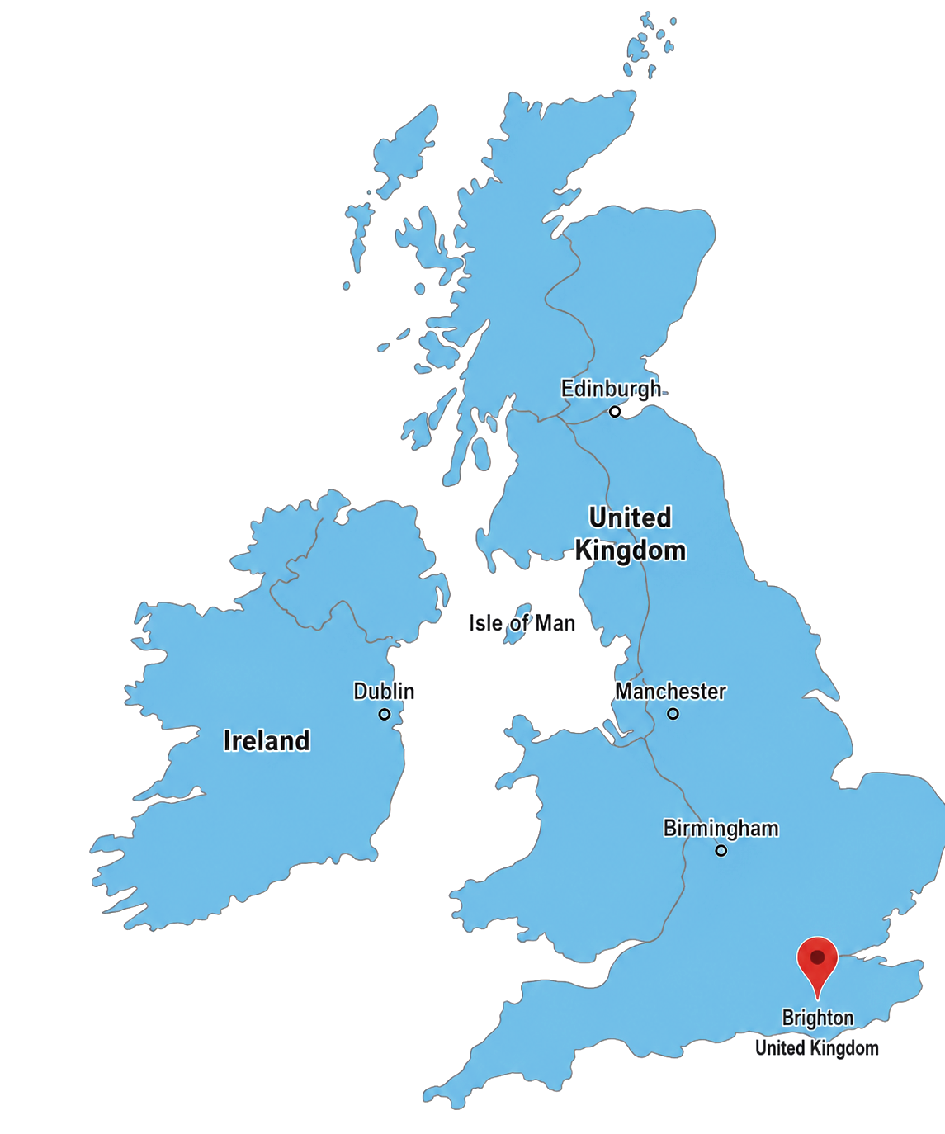
Brighton Collaboration
Conceived in1999 at a vaccine conference in Brighton UK
  Recognized need to improve quality of vaccine safety data
    9 different cut-offs for fever across 120 studies
    11 different cut-offs for local reaction size across 102 studies
Launched in 2000: independent, international, voluntary collaboration
Early and sustained focus on creation of harmonized case definitions to enable comparability of vaccine safety data across:
  Clinical trials
  Epidemiologic studies
  Surveillance systems
  Individual case reports

Slide 6

Brighton Collaboration Case Definitions: from 6 in 2004 to 78 by 2026
Multiple event types
  systemic reactogenicity
  local reactogenicity
  organ specific
  pregnancy outcomes
    maternal
    fetal
    neonatal
Common format for all

Slide 7


Brighton Collaboration Case Definitions: Purpose drives Format
Harmonize data across entire vaccine life cycle:
  Pre- and post-licensure
  Clinical trials
  Epidemiologic studies
    Background incidence
    Causality assessment
  Pharmacovigilance
    Individual case reports
    Signal management
Apply to high and low resource settings
Versatile for:
  Case finding → sensitivity
  Case validation → specificity
Enable guidance for:
  prospective data collection
  follow-up to improve specificity
Criteria define levels of diagnostic certainty
  Level 1 = definite case
  Level 2 = probable case
  Level 3 = possible case
Allow all events to be classified
  Meets case definition: Level 1, 2 or 3
  Doesn’t meet case definition:
    Level 4 – insufficient information
    Level 5 – not a case
Applicable to exposed and non-exposed
  Vaccine-to-event interval not a criterion for majority of case definitions
Criteria adaptable for
  Prospective data collection forms
  Guidance on needed follow-up data
Notes:
Key point from BC editorial publications ‘…. ensure that definitions are not used as a filter for reporting of events, events that are missing the information needed to meet even the lowest level of diagnostic certainty can be analyzed as an additional category”
In clinical trials and for individual case reports in pre-and postlicensure settings: the Case Definition and guidelines can be used to develop data collection forms to:
assure that prospectively collected information on a given AE will reach a sufficient level of certainty of its diagnosis
enable meaningful interpretation of the event and future comparability with reports of the same AE in other studies
Minimize need for each research group to develop their own CD or data collection forms
For regulators, CD and guidelines can be used to enhance conformity of the evaluation of new products
In surveillance systems and epi studies: the CD and guideline can be used to
guide followup on reported cases, thus ensuring collection of complete information
develop surveillance forms in systems that incorporate CDs at the level of reporting – e.g. CAEFISS form checkboxes
enhance Web-based reporting: pop=up window with respective items from the definition and data collection guidelines prompting the reporter for information if key words are mentioned in the report E.g. - ;fever’, ‘weakness’

Slide 8

Brighton Collaboration Case Definitions: Format not intended to
Criteria define levels of diagnostic certainty
  Level 1 = definite case
  Level 2 = probable case
  Level 3 = possible case
Allow all events to be classified
  Meets case definition: Level 1, 2 or 3
  Doesn’t meet case definition:
    Level 4 – insufficient information
    Level 5 – not a case
Applicable to exposed and non-exposed
  Vaccine-to-event interval not a criterion for majority of case definitions
Criteria adaptable for
  Prospective data collection forms
  Guidance on needed follow-up data
Guide case management
Indicate case severity
Assign causality
Serve as a filter to omit cases with:
  Lower level of diagnostic certainty
  Insufficient information
Notes:
Key point from BC editorial publications ‘…. ensure that definitions are not used as a filter for reporting of events, events that are missing the information needed to meet even the lowest level of diagnostic certainty can be analyzed as an additional category”

Slide 9

Brighton Collaboration Case Definitions
“…..case definitions alone, while providing an analytic tool to researchers that will assure them to ‘mean the same thing when they call it the same name’, do not suffice to reach the goal of data comparability.”
  aThe Brighton Collaboration: enhancing comparability of vaccine safety data. Kohl et al Pharmacoepidemiology and Drug Safety 2003; 12:335-340
Mid-2000s: first Automated Brighton Classification (ABC) Tool
  to assist users in uniform application of case definitions
SPEAC digital transformation has redesigned and updated the ABC Tool
Notes:
Key point from BC editorial publications ‘…. ensure that definitions are not used as a filter for reporting of events, events that are missing the information needed to meet even the lowest level of diagnostic certainty can be analyzed as an additional category”

Slide 10

Introduction to ABC Tool
Dr. Dale Nordenberg

Slide 11
Introduction to the ABC Tool
A quick technical overview before we go online
Standardized AEFI classification
Guides users through structured questionnaires built on Brighton Collaboration case definitions.
Assigned automatic Level of Diagnostic Certainty (LOC)
The tool calculates the appropriate Level of Diagnostic Certainty from the data entered — no manual scoring.
Delivered via the CEPI Vaccine Safety Intelligence (CVSI) Portal
Web-based; no local software install required.
Individual adverse event classification
01
De-identified information
02
Case data saved for future access
03
ABC Tool Orientation | SPEAC / Brighton Collaboration Webinar
2

Slide 12
Accessing the ABC Tool
Registration is required before first use
STEP 0
Register for portal access at portal.speacsafety.net/registration — enter name, email, and password; confirm your email to activate the account.
1
Portal Login
2
Direct URL
Go to portal.speacsafety.net
Enter email + password → Log In
Land on your dashboard
Click “ABC Tool” to launch the tool
Go directly to abc.speacsafety.net
Enter email + password → Log In
Bypasses the general dashboard
Fastest route for repeat users
ABC Tool Orientation | SPEAC / Brighton Collaboration Webinar
3

Slide 13
Orientation: How a Case Moves Through the ABC Tool
1
2
3
4
Select case definition
Answer structured questions
Tool applies the algorithm
Receive Level of Diagnostic Certainty
→
→
→
Choose the Brighton Collaboration AESI relevant to the reported event.
Work through a guided questionnaire covering clinical criteria and available evidence.
Responses are mapped automatically against the published case-definition criteria.
The tool returns the LOC (e.g., 1–5) with the criteria driving that result.
Additionally, the tool shows a dynamic diagram showing the path to the relevant LOC.
ABC Tool Orientation | SPEAC / Brighton Collaboration Webinar
4

Slide 14
Resources & Support
Everything you need to get started, in one place
Register
Portal.speacsafety.net/registration
Tool overview page
Speacsafety.net/abc-tool
Demo video
Walkthrough with thrombocytopenia & Guillain-Barré examples (SPEAC YouTube)
Support
Speac-contact@speac-cepi.net or the portal Help Desk ticketing system
ABC Tool Orientation | SPEAC / Brighton Collaboration Webinar
6

Slide 15

ABC Tool Demo
Dr. Barbara Law

Slide 16
ABC Tool Demonstration:
  Classify two cases – Generalized convulsive seizure; Myocarditis
  Highlight ABC Tool functionalities
    Case by case classification of 18 different AESIs
    Structured question format
    Definition of medical terms
    Automated LOC calculation
    Summary of data entered and pathway to LOC
    Printable / downloadable PDF
    Cases saved and can be revisited if new information found
    Cases can be deleted whenever user chooses
    AESI with similar presentations can be classified using one data form
    Help available
ABC Tool

Slide 17
Panel Discussion

Slide 18

Dr. Biniyam Tedla
Clinical Researcher
Ethiopia

Slide 19
Introduction
Biniyam Tedla Mamo: MD, MPH
Medical doctor and clinical researcher based in Ethiopia
vaccine safety and AEFI monitoring expert at EFDA

Slide 20
ABC tool: use and challenges
Use of ABC tool
Experience using of ABC tools
Initially used the paper-based ABC tool for hospital-based sentinel study in Addis Ababa Ethiopia. https://doi.org/10.1016/j.vaccine.2024.06.046
in serious case investigation related to vaccine (case assortment)
signal detection used for case assortment and valid diagnosis
Challenges
Particularly using a paper-based ABC tools : Time consuming
Resource limitation of the hospital and difficult to achieve high level of diagnostic certainty ( level 1 or level 2) particularly neurological cases.

Slide 21

Dr. Walter Straus
Moderna
USA

Slide 22
Dr. Walter Straus – BIO
Physician epidemiologist with:
  EIS training at the US Centers for Disease Control and Prevention
  over 30 years vaccine research experience
  over 25 years working in the private sector:
    epidemiology,
    clinical development
    pharmacovigilance
Brighton Collaboration member →
  case definitions & BRAVATO safety templates
CIOMS Working Group member
  Active Vaccine Safety Surveillance
  Artificial Intelligence in Pharmacovigilance
Since 2021 has led the Moderna COVID vaccine safety team

Slide 23
Dr. Walter Strauss
  ABC Tool Perspective:
    Needs to accurately and reliably apply the Brighton case definitions
    For use in a Good x Practice* (GxP) environment, needs to have
      Validation
      Controls
      Documentation
      Oversight
    For private sector needs to be efficiently integrated into existing workflow processes without adding complexity or delay
*Quality guidelines and regulations | X could be clinical, laboratory, manufacturing, distribution, storage, pharmacovigilance, and documentation.

Slide 24

Prof. Florence van Hunsel
Lareb
Netherlands

Slide 25
Prof. Florence van Hunsel – BIO
Pharmacist
Netherlands Pharmacovigilance Centre Lareb since 2005
  Senior Epidemiologist in the infectious diseases team
  Currently leads Safety Innovation
  Head of Signal detection for 10 years
  Coordinated signal detection work during COVID-19 pandemic
Nov 1 2025: Prof. of Pharmacovigilance at U.Groningen
  Chair in Groningen Research Institute of Pharmacy (GRIP)
  Research focus: methodologic innovation in drug and vaccine pharmacovigilance
Member of:
  EMA Signal Management Review Technical Working Group
  Vaccine monitoring Collaboration for Europe (VAC4EU)
  Vaccine Special Interest Groups of ISoP and ISPE

Slide 26

Lareb & Vaccine safety surveillance
We distinguished different types of safety signals, for which signal detection relied on Spontaneous Reporting and/or Intensive Monitoring cohort data.
Different methods of (statistical) analysis
Case-by-Case signal detection of serious events/AESI
Custom-made electronic Reaction Monitoring Reports (eRMR)
Observed/Expected analysis
Reporting rates for SRS/Incidence rates for Intensive Monitoring Cohort
Multivariate logistic regression analysis for cohort data
Batch analysis
Spontaneous reporting system
  In 2025 4,823 Individual Case Safety Reports (ICSR on vaccines in total
  During Covid-19 pandemic 2021-2022 > 250,000 ICSRs received, processed and assessed in a short time span
In addition large cohort event monitoring (CEM) studies

Slide 27
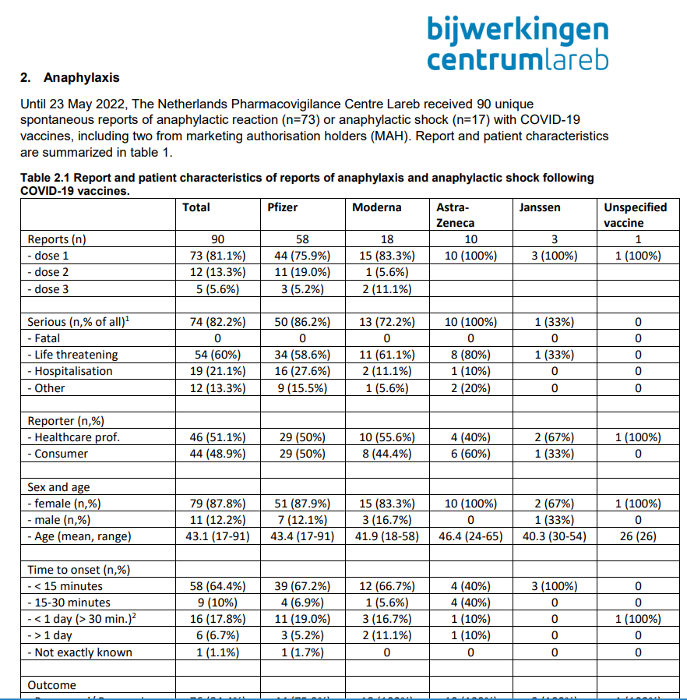
Lareb & Vaccine safety surveillance
We distinguished different types of safety signals, for which signal detection relied on Spontaneous Reporting and/or Intensive Monitoring cohort data.
Different methods of (statistical) analysis
Case-by-Case signal detection of serious events/AESI
Custom-made electronic Reaction Monitoring Reports (eRMR)
Observed/Expected analysis
Reporting rates for SRS/Incidence rates for Intensive Monitoring Cohort
Multivariate logistic regression analysis for cohort data
Batch analysis
Spontaneous reporting system
  In 2025 4,823 Individual Case Safety Reports (ICSR on vaccines in total
  During Covid-19 pandemic 2021-2022 > 250,000 ICSRs received, processed and assessed in a short time span
In addition large cohort event monitoring (CEM) studies

Slide 28
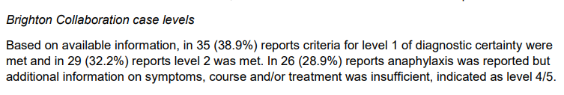
Lareb & Vaccine safety surveillance
We distinguished different types of safety signals, for which signal detection relied on Spontaneous Reporting and/or Intensive Monitoring cohort data.
Different methods of (statistical) analysis
Case-by-Case signal detection of serious events/AESI
Custom-made electronic Reaction Monitoring Reports (eRMR)
Observed/Expected analysis
Reporting rates for SRS/Incidence rates for Intensive Monitoring Cohort
Multivariate logistic regression analysis for cohort data
Batch analysis
Spontaneous reporting system
  In 2025 4,823 Individual Case Safety Reports (ICSR on vaccines in total
  During Covid-19 pandemic 2021-2022 > 250,000 ICSRs received, processed and assessed in a short time span
In addition large cohort event monitoring (CEM) studies

Slide 29
ABC Tool
There is a great instruction video!
Using the ABC tool may help with consistency of assigning BC levels between assessors
Helpful that you get two for one results, for instance in case of GBS you also get results for Miller Fisher syndrome
You always have the latest version of the BC case classification
Printer icon with info on the answers in PDF form → can be stored with the case. Helps with transparency
Small test against previously assessed anaphylaxis cases:
ABC tool easy to use
Lareb is on occasion stricter than the tool in case level assignment (based on retrospectively assessed cases)

Slide 30
ABC Tool
Not all BC case definitions are available (yet?)
  For instance, ‘Abscess at injection site’ (2007) or ‘Hypotonic-Hyporesponsive Episode (HHE) as an adverse event following immunization’ (2007)
Automatic integration in own PV ICSR system possible?
Challenges with the BC criteria in SRS
  Lack of data → FU request is time consuming for reporter and assessor
  Coding challenges of BC criteria outcomes in PV database:
    Example: No MedDRA® code is present for ‘abscess of infectious etiology’ only ‘injection site abscess sterile’ or ‘injection site abscess’ are available.

Slide 31
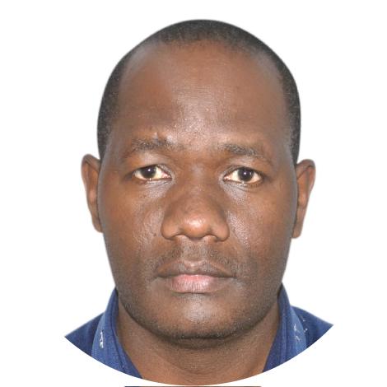
Dr. Emmanuel Masunga
Tanzania Medicines and Medical Devices Authority
Tanzania

Slide 32

Dr. Rebecca Chandler
CEPI Clinical Dev. Vaccine Safety Lead, PL for SPEAC
United Kingdom

Slide 33

Audience Q & A
If you have questions, please use the Q&A box. We will try to address most of them during today’s session. If not, we can do it afterwards.
Please add your name so we can follow up with you if needed.
At the end of the session, we will also share a short questionnaire to gather your feedback on the webinar and the ABC Tool. We would appreciate your input!

Slide 34
What's Coming Next – Dr. Dale Nordenberg
Capabilities on the near-term roadmap
COMING SOON
COMING SOON
COMING SOON
Batch Case Processing
Sharing
API for Classification
Upload many cases at once and bulk-export the results, instead of working case by case.
Share completed classifications and cases with colleagues or reviewers directly in the tool.
Programmatic access lets external systems submit case data and receive a Level of Certainty directly.
BENEFITS
BENEFITS
BENEFITS
Turns hours of repetitive data entry into a single upload
Bulk export of results for reporting & downstream analysis
Consistent, standardized output across an entire case series
Supports team-based review and second-opinion workflows
No more emailing exports back and forth between reviewers
Keeps a shared, auditable record of who reviewed what
Connects the ABC Tool to existing pharmacovigilance & EDC systems
Removes manual re-entry between systems, cutting errors
Enables near real-time classification in automated workflows
Expanding AESI library: 18 AESIs are supported today — more are coming in the next few weeks.
+
ABC Tool Orientation | SPEAC / Brighton Collaboration Webinar
6

Slide 35


Thank you!
We will contact you soon, when the slide deck and the recording of today’s webinar are available at SPEAC and Brighton’s websites.
Please share.

